Slide 1
Employee Data Analysis using Excel
STUDENT NAME: R.KIRUTHIKA
REGISTER NO: 312216970(EE1FD1AD26FBA05B6C14FE38E0686067)
DEPARTMENT: B.COM(G)
COLLEGE: SHRI KRISHNASWAMY COLLEGE FOR WOMEN

Slide 2
PROJECT TITLE
USING PIVOT TABLES FOR EMPLOYEE TURNOVER ANALYSIS

Slide 3


AGENDA
INTRODUCTION
DATA PREPARATION
CREATING PIVOT TABLE
ANALYZING KEY METRICS
VISUALIZATION AND REPORTING
ACTIONABLE INSIGHTS AND RECOMMENDATIONS
Q&A DISCUSSION
NEXT STEPS
CONCLUSION
3/21/2024 Annual Review

Slide 4

PROBLEM STATEMENT
DEPARTMENT ANALYSIS
ROLE ANALYSIS
TENURE ANALYSIS
REASON FOR LEAVING
TREND ANALYSIS

Slide 5

PROJECT OVERVIEW
DATA COLLECTION
DATA PREPARATION
PIVOT TABLE CREATION
ANALYSIS AND INSIGHTS
REPORTING
RECOMMENDATION

Slide 6

WHO ARE THE END USERS?
HUMAN RESOURCES MANAGER
DEPARTMENT MANAGERS
SENIOR MANAGEMENT
DATA ANALYST
ORGANISATIONAL DEVELOPMENT SPECIALIST
FINANCE DEPARTMENT

Slide 7

OUR SOLUTION AND ITS VALUE PROPOSITION
OUR SOLUTION
DYNAMIC DATA INTEGRATION
CUSTOMIZABLE PIVOT TABLES
ADVANCE FILLING AND AGGREGATION
INTERACTIVE DASHBOARD
VALUE PREPOSITION
ENHANCED ANALYTICAL CAPABILITIES
INFORMED DECISION MAKING
EFFICIENCY AND TIME SAVING
IMPROVED EMPLOYEE RETENTION

Slide 8
Dataset Description
EMPLOYEE ID
DEPARTMENT
JOB ROLE
TENURE
REASON FOR LEAVING
EXIT DATE
JOIN DATE
EMPLOYMENT STATUS

Slide 9

THE "WOW" IN OUR SOLUTION
DYNAMIC DATA EXPLORATION
CUSTOMIZABLE VIEWS
REAL TIME DATA ANALYSIS
IDENTIFYING HIDDEN PATTERN
TIME EFFICIENCY
COMPREHENSIVE REPORT
3/21/2024 Annual Review
9

Slide 10
MODELLING
DATA PREPARATION
CREATE PIVOT TABLE DEFINE PIVOT TABLES STRUCTURE ANALYZE TRENDS AND PATTERN VISUALIZATION
REPORTING AND ACTION
10

Slide 11
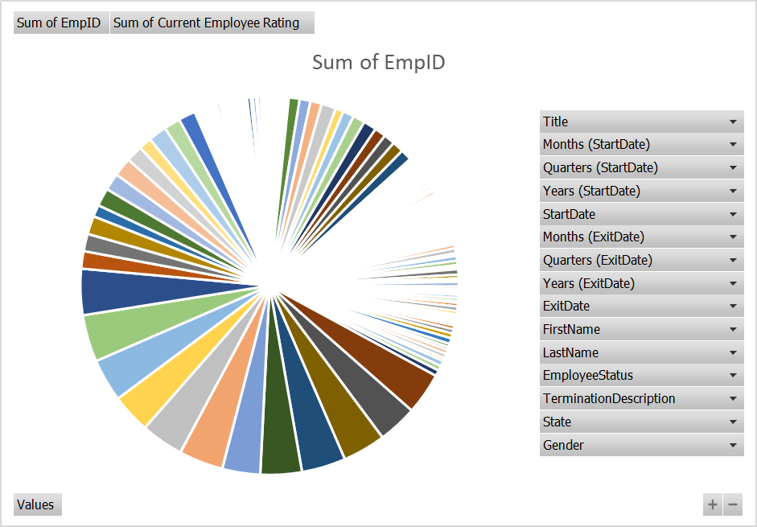
RESULTS
11

Slide 12
CONCLUSION
COMPREHENSIVE INSIGHTS
DATA DRIVEN DECISION MAKING
TAILORED STRATEGIES
TREND ANALYSIS
IMPROVED RRPORTING AND COMMUNICATION
EFFICIENCY AND FLEXIBILITY

